Slide 1
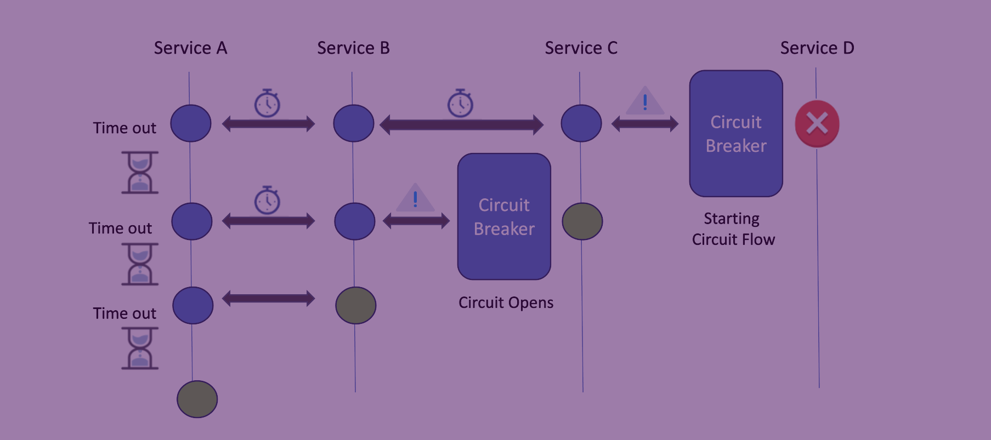
Circuit Breaker
Design Pattern
Presented by:
Hanie Gholampour

Slide 2
Outlines
01
03
05
Introduction to Circuit Breaker
How to apply a Circuit Breaker?
Conclusion
How a Circuit Breaker works?
Where to use this design pattern?
02
04

Slide 3
Outlines
01
03
05
Overview and Definitions
Importance of handling failures
Why Circuit Breaker
Introduction to Circuit Breaker
How to apply a Circuit Breaker?
Conclusion
How a Circuit Breaker works?
Where to use this design pattern?
02
04

Slide 4
Outlines
01
03
05
States of a Circuit Breaker
Real-World Example
Introduction to Circuit Breaker
How to apply a Circuit Breaker?
Conclusion
How a Circuit Breaker works?
Where to use this design pattern?
02
04

Slide 5
Outlines
01
03
05
Pseudocode to Implement
Best Practices
Introduction to Circuit Breaker
How to apply a Circuit Breaker?
Conclusion
How a Circuit Breaker works?
Where to use this design pattern?
02
04

Slide 6
Outlines
01
03
05
Benefits
Challenges
Introduction to Circuit Breaker
How to apply a Circuit Breaker?
Conclusion
How a Circuit Breaker works?
Where to use this design pattern?
02
04

Slide 7
Outlines
01
03
05
Summarize Key words mentioned
Q &A
Resources
Introduction to Circuit Breaker
How to apply a Circuit Breaker?
Conclusion
How a Circuit Breaker works?
Where to use this design pattern?
02
04

Slide 8


01 – Overview and Definitions
Electrical Component
Protects the Circuit By Interrupting the Flows In the event of Fault

Slide 9
01 – Overview and Definitions
Design Pattern
It’s a Fault Tolerance Pattern that enhances the Resilience of the system where microservices communicate with each other

Slide 10



01 – Importance of Handling Failures
In microservices, we often face challenges called "Failures”.
multiple reasons that cause failures:

Slide 11




01 – Importance of Handling Failures

Slide 12
01 – Importance of Handling Failures
01 – Importance of Handling Failures
Cascading Failure
The Circuit Breaker pattern prevents an application from performing an operation that is likely to fail.
Handling failures gracefully is paramount in ensuring the reliability of our applications.

Slide 13
01 – Why Circuit Breaker
Circuit Breaker
A
B
The Circuit Breaker logic will decide if the requests from A will be passed through or rejected or returned with an error.

Slide 14
02 – States of a Circuit Breaker
CLOSED
OPEN
It operates in three main states
HALF OPEN

Slide 15

02 – States of a Circuit Breaker
CLOSED
Threshold: 50%
OPEN
5 Sec

Slide 16
02 – States of a Circuit Breaker
CLOSED
Threshold: 50%
OPEN
5 Sec
HALF OPEN
Limited Test Request

Slide 17


02 – States of a Circuit Breaker
CLOSED
Threshold: 50%
OPEN
5 Sec
HALF OPEN
Limited Test Request

Slide 18
02 – Real World Example
CLOSED
A
B

Slide 19
02 – Real World Example
Open
CLOSED
A
B

Slide 20
02 – Real World Example
CLOSED
Half Open
A
B

Slide 21
02 – Real World Example
Half Open
Open
A
B

Slide 22
02 – Real World Example
Prevent Cascading Failure by
Half Open
Open
monitoring the health of an external service, automatically stopping requests to it if it detects a high failure rate, quickly isolating and containing the impact of failures in one part of the system.
A
B

Slide 23
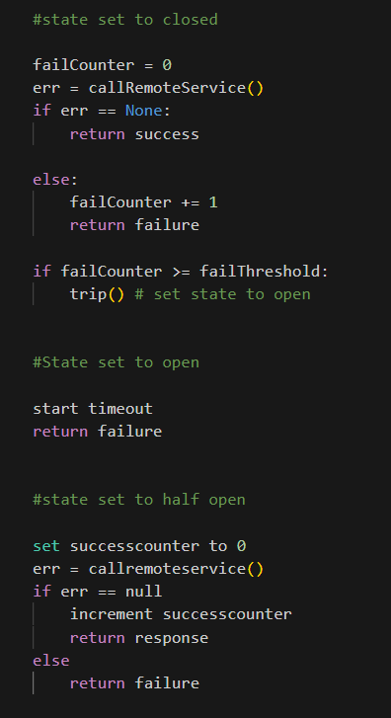

03 – Pseudocode to Implement
CLOSED
.
CLOSED
OPEN
OPEN
HALF OPEN
HALFOPEN
Notes:
OK, Best Practices: while we're designing the circuit breaker pattern, we have a lot of control over how we can write the logic in the circuit breaker pattern and make it intelligent. I'm gonna talk about some of those considerations to make the code more intelligent.
Let's see the first one: Types and count of errors, you might have 2 or more types of errors and only one of them forces the system to stop. So you can see this condition in your implementation.

Slide 24
.
03 – Pseudocode to Implement
CLOSED
CLOSED
OPEN
OPEN
HALF OPEN
HALF OPEN
.
Notes:
the second one is times out and delays, Imagine you have set a time for 10 mili seconds to switch between Open to Halfopen state, the time that the system takes to recover, this timing might be too much to check and switch, So you need to be more careful about setting this delay and change it to a more suitable timeout when necessary.

Slide 25
CLOSE
03 – Pseudocode to Implement
CLOSED
OPEN
HALF OPEN
OPEN
.
HALF OPEN
Notes:
last but not least, is the Logging and Monitoring. The transitions from one state to another, are taking place. we need to log the transitions and monitor them to see if something is going wrong or working out of our expectations. also, we have all the data in order to track the failures and then maybe fix those failures to avoid that error again.

Slide 26
03 – Best Practices
while we're designing the circuit breaker pattern, we have a lot of control over how we can write the logic in the circuit breaker pattern and make it intelligent.

Slide 27




03 – Best Practices
Types and Count of Errors
Timeouts and Delays
Logging and Monitoring
Open
HALF OPEN
Open
HALF OPEN
CLOSED

Slide 28
03 – Best Practices
Timeouts and Delays
Logging and Monitoring
Types and Count of Errors
Open
HALF OPEN
Open
HALF OPEN
CLOSED

Slide 29
03 – Best Practices
Logging and Monitoring
Types and Count of Errors
Timeouts and Delays
Open
HALF OPEN
Open
HALF OPEN
CLOSED

Slide 30


04 – Benefits
01
Circuit Breaker prevents cascading failures.
02
03
04
05
This pattern handles errors gracefully and provides better under experience.

Slide 31

This pattern prevents cascading failures.
04 – Benefits
01
Circuit Breaker handles errors gracefully and provides better under experience.
02
03
04
05
This pattern reduces the application downtimes.

Slide 32

This pattern prevents cascading failures.
This pattern handles errors gracefully and provides better under experience.
04 – Benefits
01
Circuit Breaker reduces the application downtimes.
02
03
04
05
This pattern suitable for handling asynchronous communications.

Slide 33

This pattern prevents cascading failures.
This pattern handles errors gracefully and provides better under experience.
This pattern reduces the application downtimes.
04 – Benefits
01
Circuit Breaker suitable for handling asynchronous communications.
02
03
04
05
This state changes of the circuit breaker can be used for error monitoring.

Slide 34
This pattern prevents cascading failures.
This pattern handles errors gracefully and provides better under experience.
This pattern reduces the application downtimes.
This pattern suitable for handling asynchronous communications.
04 – Benefits
01
This state changes of the circuit breaker can be used for error monitoring.
02
03
04
05

Slide 35
04 – Challenges
01
Circuit Breaker Need good infrastructure management to maintain circuit breakers.
02
Throughput issues in services if not properly configured.
03
Difficult to test.

Slide 36
04 – Challenges
01
Need good infrastructure management to maintain circuit breakers.
02
Circuit Breaker Throughput issues in services if not properly configured.
03
Difficult to test.

Slide 37
04 – Challenges
01
Need good infrastructure management to maintain circuit breakers.
02
Throughput issues in services if not properly configured.
03
Circuit Breaker Difficult to test.

Slide 38
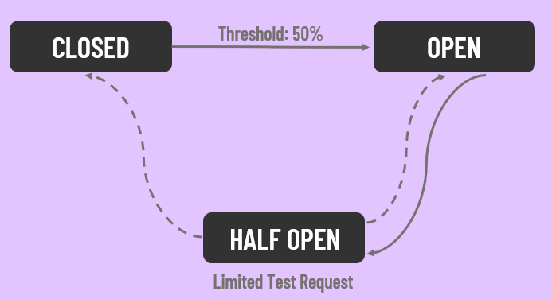

05 – Summarized Keywords Mentioned
Introduction

Slide 39
05 – Summarized Keywords Mentioned
States

Slide 40
05 – Summarized Keywords Mentioned
Implementation

Slide 41
05 – Summarized Keywords Mentioned
Usage

Slide 42

Q&A

Slide 43
05 – Resources
Wikipedia
Author: DavidEfraim
8 Nov. 2023, Circuit breaker design pattern
Medium Articles
Author: Hasitha Subhashana
12 Jun. 2021, Circuit Breaker Pattern (Design Patterns for Microservices)
Microservices.io
Author: Chris Richardson
27 Dec. 2023, Pattern: Circuit Breaker
Java67.com
Author: Javin Paul
27 May. 2023, What is Circuit Breaker Design Pattern in Microservices? How to implement it?
Learn.microsoft.com
Author: Azure
Recently, Circuit Breaker pattern
MartinFolwer.com
Author: Martin Fowler
6 Mar. 2014, CircuitBreaker
LinkedIn NewsLetter
Author: codeonedigest cod
31 May. 2023, Circuit Breaker Microservice Design Pattern Tutorial with Examples for API Developers

